Slide 1
TRIPLO AGONISMO PER IL TRATTAMENTO DELL’OBESITA’
Esmeralda capristo
Direttore UOS DI Medicina della grande Obesità
Fondazione Policlinico Universitario A. Gemelli IRCCS – ROMA
esmeralda.capristo@unicatt.it

Slide 2
Disclosures
- Eli Lilly
- Novo Nordisk

Slide 3
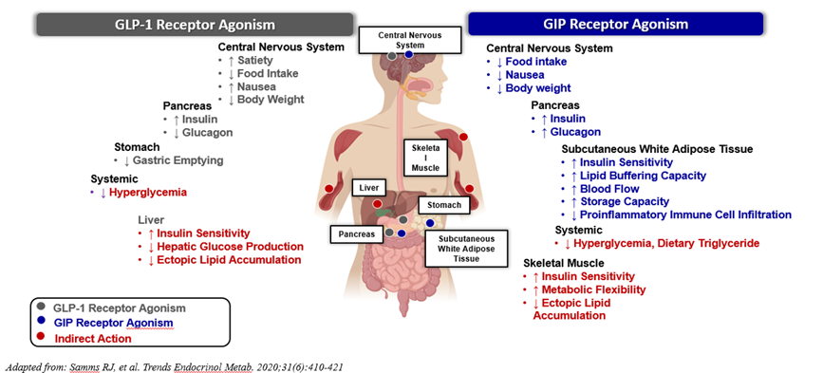
GLP-1 and GIPR: mediated actions

Slide 4

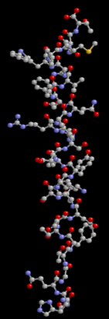
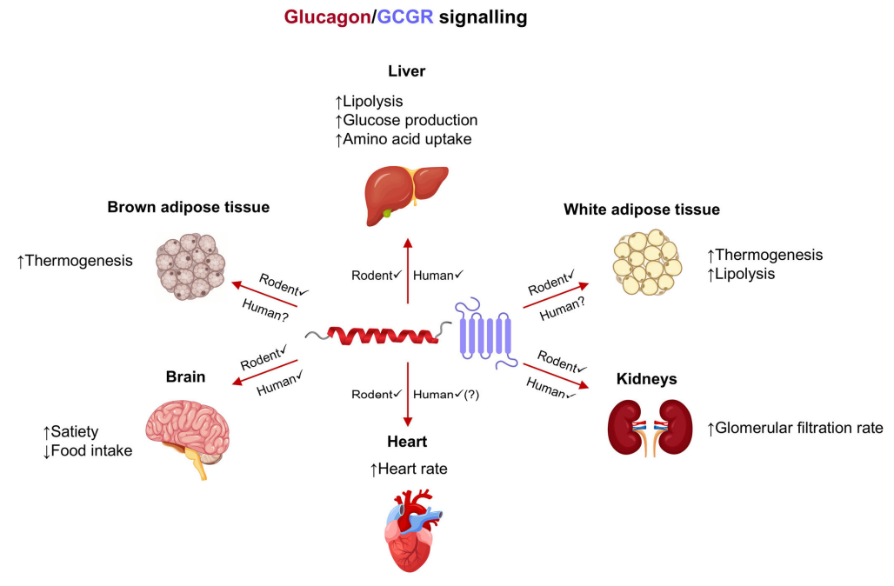


Effects of glucagon receptor agonism with potential relevance for obesity, MASLD and other cardiokidney-metabolic conditions
gastric emptying rate
GCGR, glucagon receptor; MASLD, metabolic dysfunction-associated steatotic liver disease.
Neff GW. Diabetes Obes Metab. 2025;1–15.
Notes:
Putative and proven effects of glucagon receptor agonism with potential relevance for obesity, MASLD, and other cardiokidney-metabolic conditions. Some effects are proposed or species-dependent or may only occur with pharmacological GCGR agonism.

Slide 5
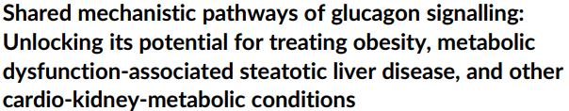
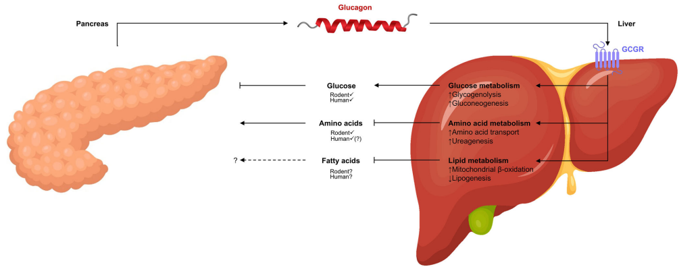
The liver–alpha cell axis
Neff GW. Diabetes Obes Metab. 2025;1–15.
Notes:
The liver–alpha cell axis. Two known feedback loops mediated by glucagon and its receptor (GCGR) on liver cells constitute the liver–alpha cell axis: (1) high or low plasma glucose levels, respectively, inhibit or stimulate pancreatic alpha-cell secretion of glucagon, resulting in decreased or increased hepatic glucose production via glycogenolysis and gluconeogenesis; (2) high or low levels of plasma amino acids, respectively, stimulate or inhibit alpha-cell secretion of glucagon, which in turn increases or decreases liver uptake of amino acids and ureagenesis. A third feedback loop involving lipid metabolism may also exist, as glucagon/GCGR signalling increases hepatic oxidation of fatty acids and decreases lipogenesis; however, it is unclear if plasma fatty acid levels regulate alpha-cell secretion of glucagon. GCGR, glucagon receptor.

Slide 6
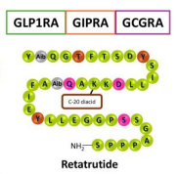

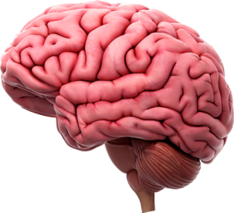
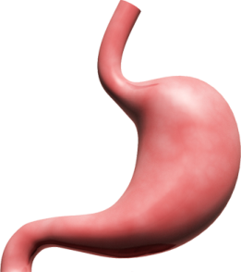
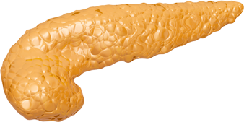
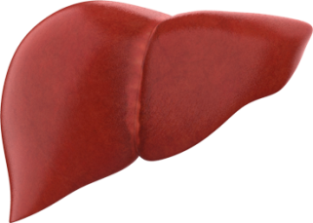
Retatrutide: Triple GIP/GLP-1/Glucagon Receptor Agonist
GIP
GLP-1
Glucagon
Adipose:
↑ Insulin sensitivity
Improvements in lipid metabolism
CNS:
Appetite
Decrease in nausea
Islets:
↑ Insulin secretion
↑ Glucagon secretion
CNS:
Appetite
Islets:
↑ Insulin secretion
↓ Glucagon secretion
Stomach:
Delayed gastric emptying
CNS:
↑ Energy expenditure
Appetite regulation
Islets:
↑ Insulin secretion
Stomach:
Delayed gastric emptying
Liver:
↑ Glycogenolysis
↑ Gluconeogenesis
Improvements in lipid metabolism
CNS=Central Nervous System; GIP=Glucose-dependent Insulinotropic Polypeptide; GLP-1=Glucagon-like Peptide-1.
Hædersdal S, et al. Nat Rev Endocrinol. 2023;19:321-35; Hammoud R, Drucker DJ. Nat Rev Endocrinol. 2023;19:201-26.

Slide 7
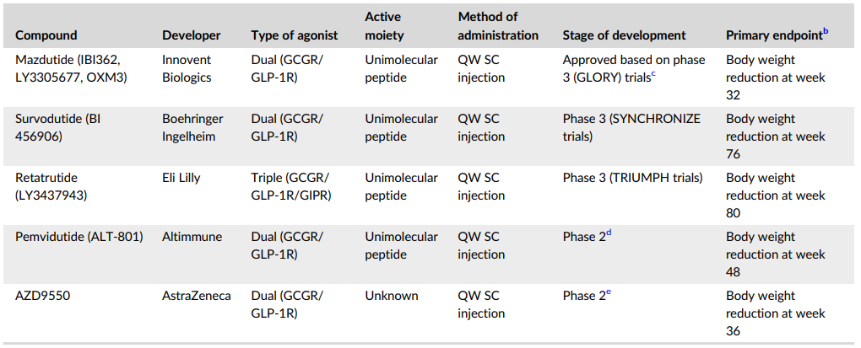
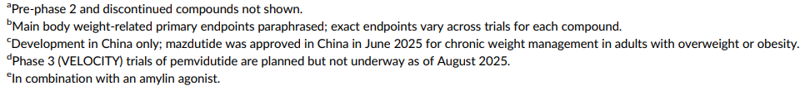
Glucagon receptor agonists in mid- to late-stage clinical trials for treatment of obesity
GIPR, glucose-dependent insulinotropic polypeptide receptor; GLP-1R, glucagon-like peptide-1 receptor; QW, once weekly; SC, subcutaneous.
Neff GW. Diabetes Obes Metab. 2025;1–15.
Notes:
Putative and proven effects of glucagon receptor agonism with potential relevance for obesity, MASLD, and other cardiokidney-metabolic conditions. Some effects are proposed or species-dependent or may only occur with pharmacological GCGR agonism.

Slide 8
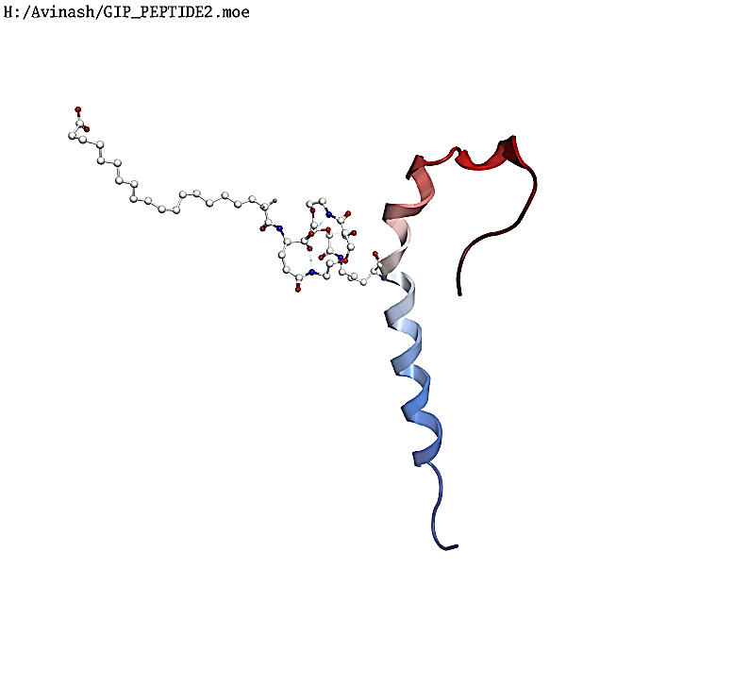
Retatrutide: GIP/GLP-1/Glucagon (GGG): Tri-Agonist
GGG Triagonist (LY3437943): Next generation incretin + to maximize tirzepatide learnings
Single peptide with triple receptor agonistic activity of glucose-dependent insulinotropic polypeptide (GIP), glucagon-like peptide-1 (GLP-1) and glucagon
Glucagon activity to enhance energy expenditure and weight loss
Glycemic control with breakthrough weight loss compared to other incretins (mouse data)
Weekly time-action profile
GGG: GLP-1/GIP/glucagon; GIP: glucose-dependent insulinotropic polypeptide; GLP-1: glucagon-like peptide-1.
Rosenstock J, et al. Lancet 2023.
Notes:
Retatrutide (LY3437943) is the first GLP-1/GIP/GCG triple agonist to complete phase 2 trials, with phase 3 studies ongoing for obesity and/or T2D management. It is a 39 amino-acid, single peptide, engineered from a GIP peptide backbone, conjugated to a C20 fatty di-acid moiety to enable albumin binding and extend its half-life. Retatrutide has ≈ 2.5-times lower potency at the GLP-1 receptor than human GLP-1, 8.9-times higher potency at the GIP-receptor than human GIP and 2.9-times lower potency at the GCG-receptor than human GCG .

Slide 9

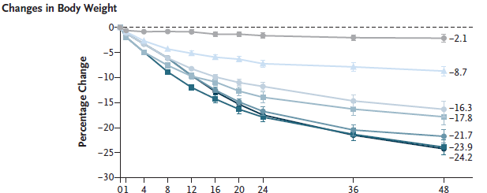
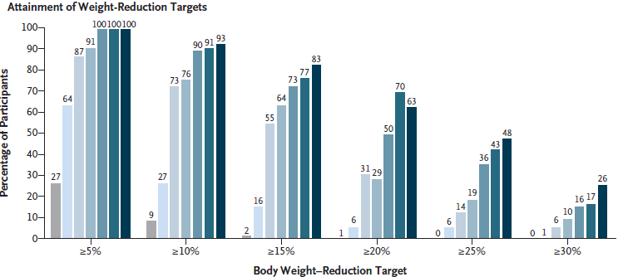
Jastreboff AM, et al. NEMJ. 2023;389:514-26.
Notes:
In this phase 2 trial, once-weekly treatment with retatrutide resulted in substantial weight reduction at 24 and 48 weeks, with dose-dependent efficacy. The results warrant further investigation in the planned phase 3 trial to inform the efficacy and safety of retatrutide for the treatment of obesity.

Slide 10
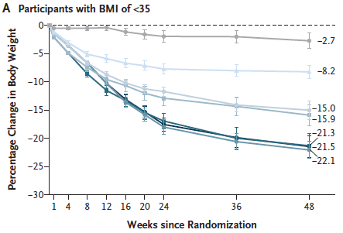
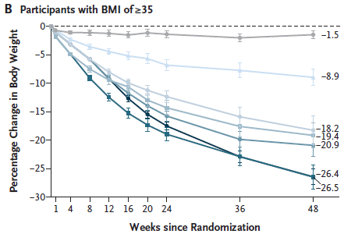
*P<.001 vs. placebo.
Data are LSM (SE); Error bars indicate SE. BMI: Body Mass Index; lD: Initial Dose; LSM: Least Squares Mean; Reta=Retatrutide.
Jastreboff AM, et al. NEMJ. 2023;389:514-26.

Slide 11
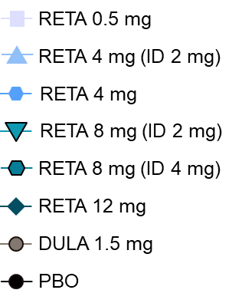
Retatrutide in type 2 diabetes: results from a phase 2 study
HbA1c reduction from baseline
% of subjects achieving different HbA1c targets
*P≤.01, **P≤.001, ***P≤.0001 vs. PBO; †P≤.01, ††P≤.001, †††P≤.0001 vs. DULA 1.5 mg; ID=Initial Dose.
Rosenstock J, et al. Lancet. 2023;doi:10.1016/S0140-6736(23)01053.
Notes:
In this randomised, double-blind, double-dummy, placebo-controlled and active comparator-controlled, parallel-group, phase 2 trial, BMI of 25–50 kg/m².
Notes:
At week 24:
A significant decrease in HbA1c levels was observed from baseline, in all RETA-treated groups
The largest mean decrease in HbA1c levels were seen in RETA 12 mg group (2.02%; 22.07 mmol/mol)
Similarly, at week 36:
The largest mean decrease in HbA1c levels were seen in RETA 12 mg group (2.16%; 23.59 mmol/mol)
At week 36:
A decrease in fasting serum glucose levels was observed from baseline, in the RETA-treated groups (4 mg (ID 2 mg), 4 mg, 8 mg (ID 2 mg), 8 mg (ID 4 mg), and 12 mg), with mean decreases ranging from 21 mg/dL to 69 mg/dL (1.2 mmol/L to 3.8 mmol/L)
Abbreviations:
BL=Baseline; DULA=Dulaglutide; HbA1c=Glycated Hemoglobin; ID=Initial Dose; LSM=Least Squares Mean; MMRM=Mixed-model Repeated Measures; PBO=Placebo; RETA=Retatrutide; SE=Standard Error.
Reference:
Rosenstock J, Frias J, Jastreboff AM, et al. Retatrutide, a GIP, GLP-1 and glucagon receptor agonist, for people with type 2 diabetes: A randomised, double-blind, placebo and active-controlled, parallel-group, phase 2 trial conducted in the USA. Lancet. 2023;doi:10.1016/S0140-6736(23)01053-X (Ahead of print).

Slide 12
Phase 2 Trial of Retatrutide in Participants With Obesity Without T2D
Parameters | Reta 1 mg (N=69) | Reta 4 mg (ID 2 mg) (N=33) | Reta 4 mg (ID 4 mg) (N=34) | Reta 8 mg (ID 2 mg) (N=35) | Reta 8 mg (ID 4 mg) (N=35) | Reta 12 mg (ID 2 mg) (N=62) | Placebo (N=70) | Total (N= 338)
Participants with AEs, n (%)
≥1 TEAEs | 58 (84.1) | 24 (72.7) | 28 (84.8) | 28 (80.0) | 33 (94.3) | 57 (91.9) | 49 (70.0) | 277(82.2)
Serious AEs | 3 (4.3) | 0 | 2 (6.1) | 1 (2.9) | 2 (5.7) | 2 (3.2) | 3 (4.3) | 13 (3.9)
Deathsª | 0 | 0 | 1 (3.0) | 0 | 0 | 0 | 0 | 1(3.0)
TEAEs occurring in ≥5% of total participants, n (%)
Nausea | 10 (14.5) | 6 (18.2) | 12 (36.4) | 6 (17.1) | 21 (60.0) | 28 (45.2) | 8 (11.4) | 91 (27.0)
COVID-19 | 13 (18.8) | 4 (12.1) | 6 (18.2) | 6 (17.1) | 12 (34.3) | 15 (24.2) | 14 (20.0) | 70 (20.8)
Decreased appetite | 9 (13.0) | 6 (18.2) | 8 (24.2) | 4 (11.4) | 11 (31.4) | 18 (29.0) | 6 (8.6) | 62 (18.4)
Diarrhea | 6 (8.7) | 4 (12.1) | 4 (12.1) | 7 (20.0) | 7 (20.0) | 9 (14.5) | 8 (11.4) | 45 (13.4)
Vomiting | 2 (2.9) | 4 (12.1) | 4 (12.1) | 2 (5.7) | 9 (25.7) | 12 (19.4) | 1 (1.4) | 34 (10.1)
Constipation | 5 (7.2) | 5 (15.2) | 2 (6.1) | 4 (11.4) | 4 (11.4) | 10 (16.1) | 2 (2.9) | 32 (9.5)
Jastreboff AM, et al. NEMJ. 2023;389:514-26.
ªAll deaths were adjudicated by an external committee of physicians as to whether the death was a cardiovascular-related death or not.
Note: Data are n (%). AE=Adverse Event; COVID-19=Coronavirus Disease 2019; ID=Initial Dose; Reta=Retatrutide; TEAE=Treatment-emergent Adverse Event; T2D=Type 2 Diabetes.

Slide 13
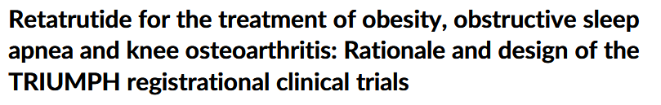
TRIUMPH consists of 4 Phase 3, multicenter, randomized, double-blind studies assessing weekly subcutaneous Retatrutide compared to placebo, in conjunction with healthy diet and physical activity in over 5800 participants.
Estimated Primary Completion Date
Participants with obesity or overweight, including those with OA or OSA
BMI >30 kg/m² or ≥27 kg/m² with obesity-related complications
TRIUMPH-1
N=2300
April 2026
Individuals with T2D and obesity or overweight, including those with OSA
TRIUMPH-2
N=1120
BMI ≥27 kg/m² with T2D
May 2026
TRIUMPH Phase 3 Clinical Development Program for Retatrutide
Participants with obesity ± T2D and diagnosed CVD
TRIUMPH-3
N=1950
BMI ≥35 kg/m² with CVD
April 2026
Participants with obesity or overweight and OA
TRIUMPH-4
N=435
BMI ≥27 kg/m² with OA
December 2025
OSA, obstructive sleep apnea; OA, osteoarthritis; BMI, body mass index; T2D, type 2 diabetes; CVD, cardiovascular disease.
Notes:
The TRIUMPH program is being conducted across 13 countries.

Slide 14
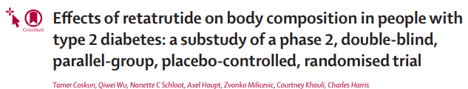
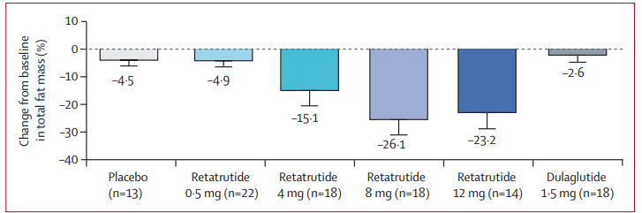
Notes:
The TRANSCEND-T2D clinical trial program evaluates investigational doses of retatrutide for the treatment of type 2 diabetes in adults.

Slide 15
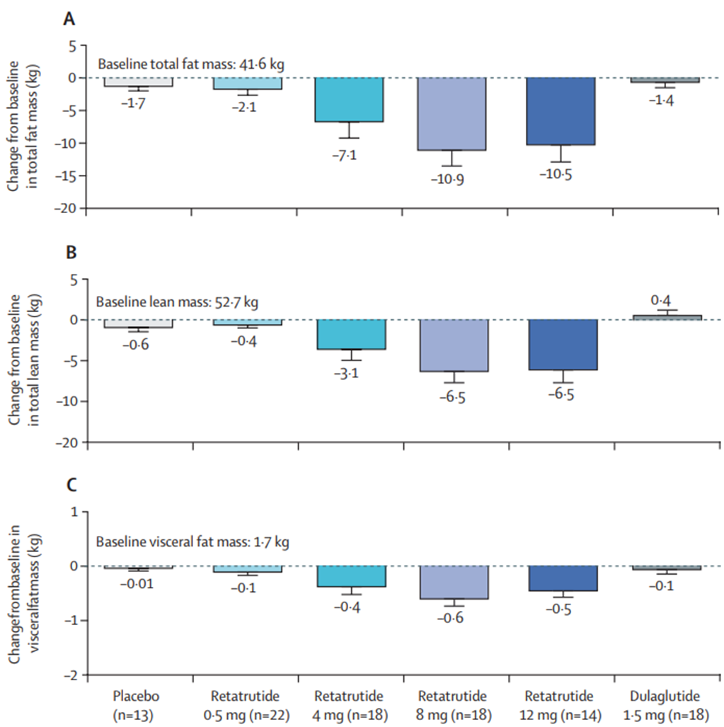
Exploratory efficacy outcomes at week 36
Data are least-squares mean (95% CI). Change from baseline in (A) total fat mass, (B) total lean mass, and (C) android visceral fat mass at week 36. Analysis included participants with non-missing baseline values and at least one non-missing postbaseline measurement.

Slide 16
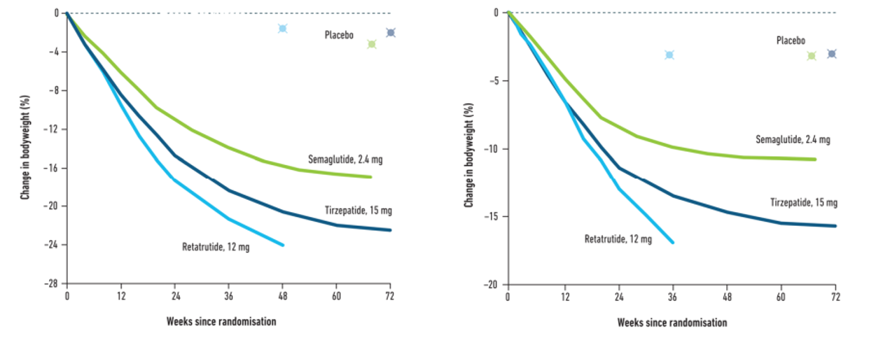
Weight loss with Retatrutide as compared to currently licenced obesity pharmacotherapy
Obesity Type 2 Diabetes
but we have to go beyond weight loss…..
Current Cardiovascular Risk Reports 2025;19(1):18.

Slide 17
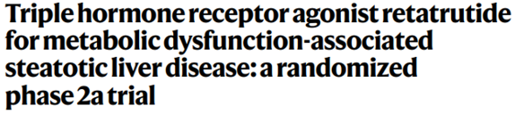
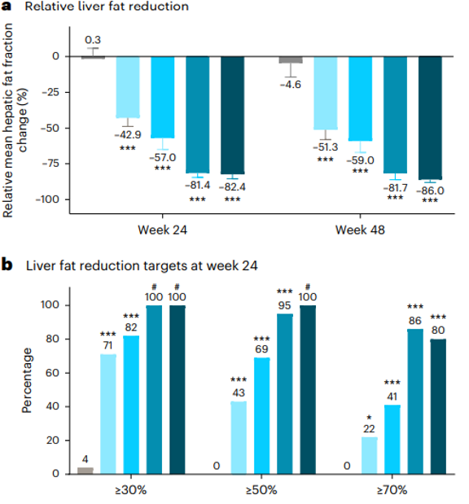
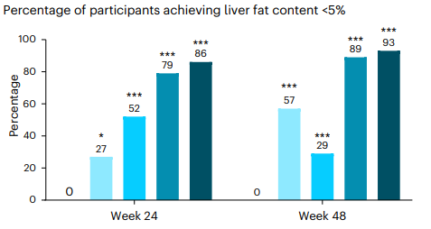
N= 98 (out of 338) > 10% liver fat content assessed by MRI-PDFF
Notes:
From 20 May 2021 to 22 November 2022, 498 participants were screened and 338 participants were randomized in the main obesity study. Of these 338, 98 (29.1%) met the inclusion criterion of 10% or greater liver fat content by magnetic resonance imaging proton density fat fraction (MRI–PDFF) for participation in the MASLD substudy.

Slide 18
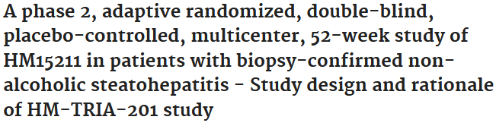
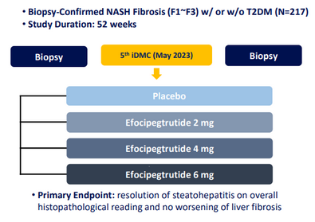
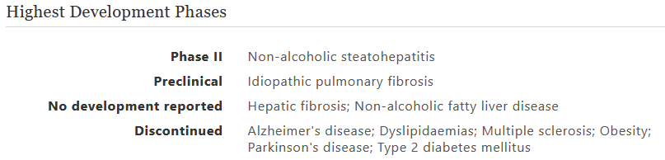
Efocipegtrutide, a triple GLP-1/GIP/GCG receptor agonist, has demonstrated significant liver fat reduction after 12 weeks in participants with MASLD and is now in phase 2 development.
Notes:
Phase 1b/2a trial in obese subjects with NAFLD found that efocipegtrutide was safe, well-tolerated, and significantly decreased liver fat and body weight.The trial observed weight reduction after 8 and 12 weeks of treatment.A Phase 2b study is currently ongoing to further evaluate its effects in patients with NASH (non-alcoholic steatohepatitis.

Slide 19
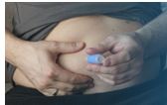

Take Home messages
Obesity is a chronic relapsing disease with a multifactorial pathophysiology and associated severe complications, thus its treatment should be long-term, multifactorial, flexible over time and tailored to the individual;
Retatrudide is a unimolecular triple GIP, GLP-1, and glucagon RA, each impacts food intake and satiety through different mechanisms. In a Phase II trial, at 48 weeks the mean reduction in baseline body weight in the retatrutide groups was 24.2% (at the highest dose) with a remarkable safety profile. It is currently being tested in a set of Phase III studies (TRIUMPH).
The development of the new Obesity management medications (OMM) with the change in therapeutic targets in terms of weight loss, will lead to consider obesity and its complications preventable.
Treat early and treat long-term beyond weight loss

Slide 20


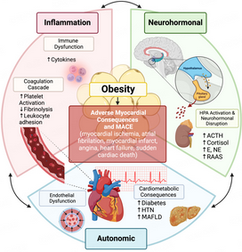


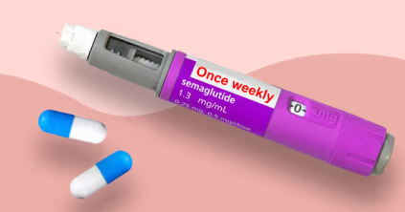
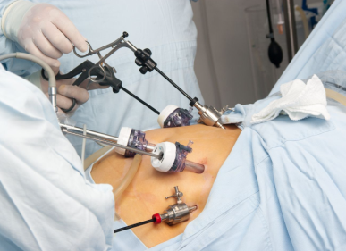
Grazie

